Slide 1
Overview
Clustered and nonclustered Indexes
Obtaining index information from DMVs
Filtered Indexes
Statistics
Index Maintenance

Slide 2

Index Fundamentals
SQL Server accesses data using a table scan or an index
In a table scan SQL Server reads all the pages
When using an index, SQL Server will use the index pages to find the required rows
Indexes can be clustered or non-clustered
Root node
Leaf nodes

Slide 3
Clustered Indexes
Rows are stored in a logical order
Only one clustered index per table
A table without a clustered index is known as a heap
All data is stored in the leaf nodes
Analogous to the contents page of a book
Defines the physical ordering of the contents

Slide 4
Operations on Clustered Indexes
INSERT
Each new row must be placed into the correct logical position
May involve splitting pages of the table
UPDATE
The new row can either remain in the same place if it still fits and if the clustering key value is still the same
If the row no longer fits on the page, the page needs to be split
If the clustering key has changed, the row needs to be removed and placed in the correct position
DELETE
Frees up space by flagging the data as unused
SELECT
Queries related to the clustering key can seek

Slide 5
Non-Clustered Indexes
Table is structured as a heap or clustered index
Heap = Index ID 0
Clustered Index = Index ID 1
Additional indexes can be created
These are called nonclustered indexes (Index ID 2+)
Separate objects to the table
Leaf level contains a pointer to the table where the rest of the columns can be found

Slide 6
Index DMVs
sys.dm_db_index_physical_stats
Index size and fragmentation statistics
sys.dm_db_index_operational_stats
Current index and table I/O statistics
sys.dm_index_usage_stats
Index usage statistics by access type

Slide 7
Filtered Indexes
Filtered indexes use a WHERE clause to limit the rows that the index includes
Benefits of filtered indexes include
Faster response times
Small storage requirement
Faster rebuild operations
Shares some similarities with Indexed Views
CREATE NONCLUSTERED INDEX
NC_EMP_ADDRESS
ON HR.Address
(
AddressLine1,
AddressLine2
)
WHERE City='New York'

Slide 8
Index Fragmentation
Fragmentation occurs when data changes cause index pages to split
Internal fragmentation when pages are not full
External fragmentation when pages are not in logical sequence
Detecting fragmentation
Index properties in SQL Server Management Studio
sys.dm_db_index_physical_stats

Slide 9
FILLFACTOR and PAD_INDEX
ALTER TABLE Person.Contact
ADD CONSTRAINT PK_Contact_ContactID
PRIMARY KEY CLUSTERED
(
ContactID ASC
) WITH (PAD_INDEX = ON, FILLFACTOR = 70);
GO
FILLFACTOR leaves space in index leaf-level pages for new data to avoid page splits
PAD_INDEX uses the value specified in FILLFACTOR for the intermediate pages of the index

Slide 10
Removing Fragmentation
REBUILD
Rebuilds the whole index
Needs free space in the database
Performed as a single transaction
Beware of log space requirements
REORGANIZE
Sorts the pages and is always online
Less transaction log usage
Work isn’t lost if interrupted
ALTER INDEX IX_Contact_LastName
ON Person.Contact
REBUILD;
ALTER INDEX IX_Contact_City
ON Person.Contact
REORGANIZE;

Slide 11
Online Index Operations
ALTER INDEX IX_Contact_EmailAddress
ON Person.Contact
REBUILD
WITH (ONLINE = ON, MAXDOP = 4 );
Enterprise Edition of SQL Server can rebuild indexes online
Enables concurrent user access
Slower than the equivalent offline operation
Effectively creates a new index in parallel with the old so space in the data file is a consideration
Lots of updates during the rebuild will use tempdb heavily

Slide 12
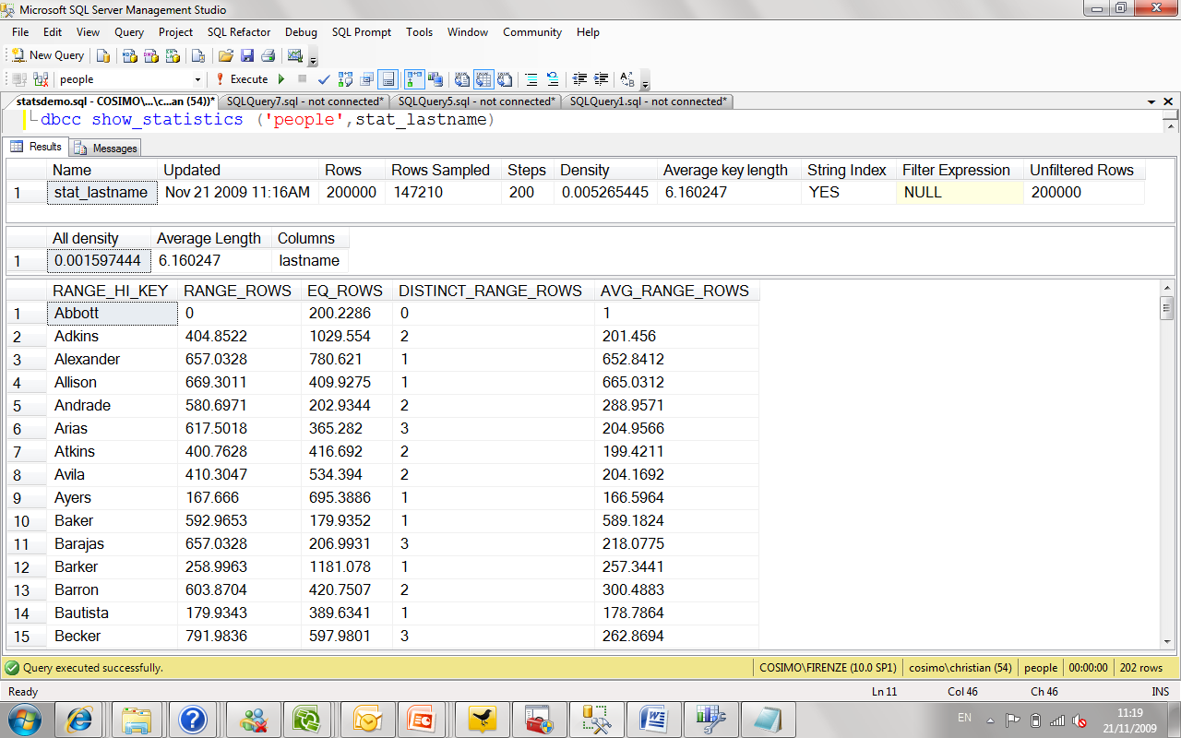
Statistics
Statistics exist to help the optimiser choose a good execution plan
They’re used to help estimate the selectivity of an operation

Slide 13
Updating Statistics
As data changes, statistics become outdated
Updated automatically or on demand
AUTO_UPDATE_STATISTICS
Database option on by default
UPDATE STATISTICS
Manually trigger an update for a table or specific statistics
sp_updatestats
Updates all statistics in a database
ALTER INDEX REBUILD
Also rebuilds the statistics with FULLSCAN

Slide 14
Summary
Clustered indexes usually faster than non-clustered
Only place non-clustered indexes on columns with high selectivity (>95% of rows are unique on that column)
Inserts, deletes, and updates are slowed.
Indexes take up space and require page hits

Slide 15
Summary
Index used only if first column in index is relevant to query
Indexes can hurt as much as they help
Make sure don’t add one by accident.
Indexes can provide structured data performance to unstructured XML

Slide 16
Summary
Is there a high level of selectivity on the data?
if yes and is frequently target of where clause, then add index
Have I dropped indexes I no longer need?
Why not?
Do I have a maintenance strategy established?
Why not?

Slide 17
Critical Questions
Are there lots of inserts or modifications to this table?
If yes, keep indexes to minimum
Is this a reporting table?
E.g. not many inserts but lots of reports run many different ways
If yes, more indexes are fine

Slide 18
Further reading…
https://www.w3schools.com/sql/sql_view.asp
https://docs.microsoft.com/en-us/sql/t-sql/statements/create-view-transact-sql
http://www.c-sharpcorner.com/blogs/advantages-and-disadvantages-of-views-in-sql-server1
https://www.mssqltips.com/sqlservertip/1206/understanding-sql-server-indexing/
https://www.w3schools.com/sql/sql_create_index.asp
https://docs.microsoft.com/en-us/sql/relational-databases/indexes/clustered-and-nonclustered-indexes-described
https://www.slideshare.net/MahabuburRahaman/introduction-of-sql-server-indexing

Slide 19
Thank You!

